Slide 1

Designing and machine learning enhancement of a low-cost optical seismometer for detecting seismic activities.
End-Term Presentation by
Neeraj Joshi
MTech (Instrument technology)
Entry No. 2021JID2579
SeNSE, IIT Delhi
Under the supervision of
Prof. Manish Kumar
Associate Professor
SeNSE, IIT Delhi

Slide 2
Content`
What is a Seismometer?
Introduction
Geophones used in existing seismometers
Problem in the existing systems
Methods and results
Selection of components
Selection of material and design
Sensor selection
Development of a compact system.
Work completed to date and future execution plans
References

Slide 3
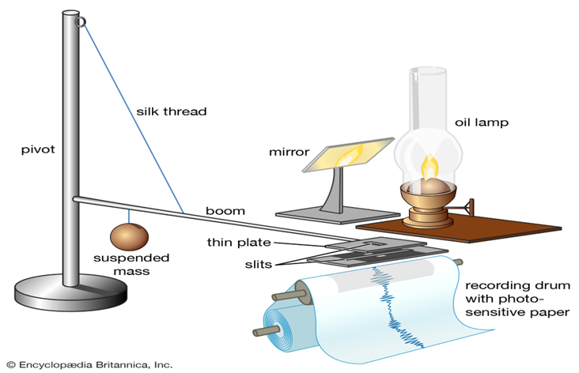
What is a Seismometer?
Seismometer, instrument that makes a record of seismic waves caused by an earthquake, explosion, or other earth-shaking phenomenon.
The first true seismograph, according to Italian seismologists, was created in 1875 by italian physicist filippo cecchi.

Slide 4
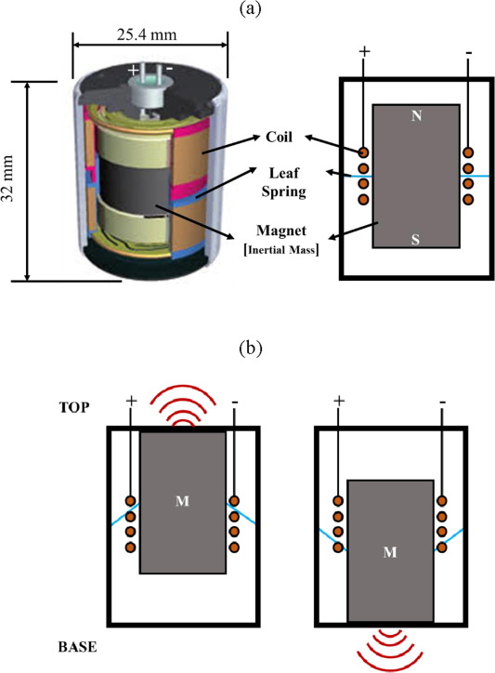
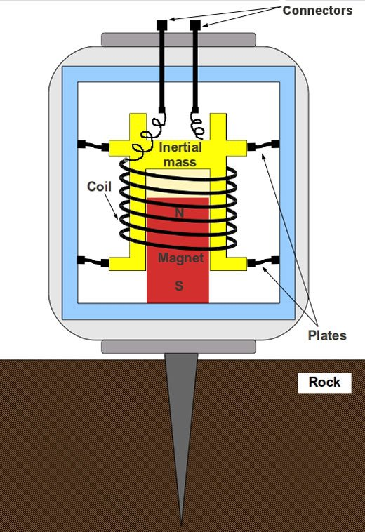
Geophones used in existing seismometers
Geophones are devices that generate electric signals proportional to the vibrations.
The case is rigidly attached to the earth . The mass mounted on a spring, however, tends to remain motionless.
A geophone is designed to be sensitive only to the component of velocity parallel to the axis of its case.
Three geophones are therefore required to measure all three components of particle velocity (for example, the vertical and two horizontal components).

Slide 5
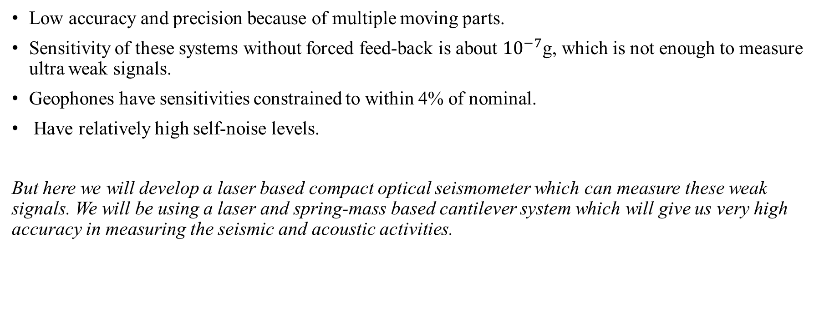
Problems associated with the existing systems
Low accuracy and precision because of multiple moving parts.
Sensitivity of these systems without forced feed-back is about ${10}^{−7}$g, which is not enough to measure ultra weak signals.
Geophones have sensitivities constrained to within 4% of nominal.
Have relatively high self‐noise levels.
But here we will develop a laser based compact optical seismometer which can measure these weak signals. We will be using a laser and spring-mass based cantilever system which will give us very high accuracy in measuring the seismic and acoustic activities.

Slide 6
Methods and results:
The methodology of the work involves the following steps:
Selection of components
Selection of material and design
Sensor selection
Development of a compact system.

Slide 7
Selection of components
Developing a cantilever based compact optical seismometer.
Studied about the principle and working of the main components of this system that are as follows:
Cantilever having a fixed mass at its end
5 Volt 650 nm laser diode
Wired mouse IC Optical sensor MX8733 DIP8L USB interface
Raspberry Pi 3 Model B (for processing and displaying results)

Slide 8
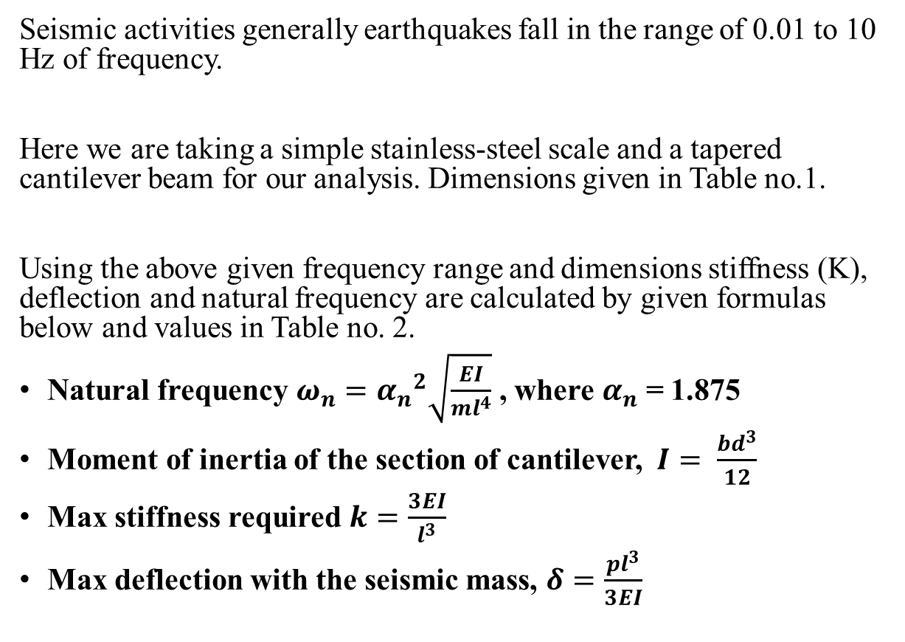
Selection of material and design
Seismic activities generally earthquakes fall in the range of 0.01 to 10 Hz of frequency.
Here we are taking a simple stainless-steel scale and a tapered cantilever beam for our analysis. Dimensions given in Table no.1.
Using the above given frequency range and dimensions stiffness (K), deflection and natural frequency are calculated by given formulas below and values in Table no. 2.
Natural frequency $ω_{n}={α_{n}}^{2}\sqrt{\frac{EI}{ml^{4}}}$ , where $α_{n}$ = 1.875
Moment of inertia of the section of cantilever, $I=$ $\frac{bd^{3}}{12}$
Max stiffness required $k=\frac{3EI}{l^{3}}$
Max deflection with the seismic mass, $δ=\frac{pl^{3}}{3EI}$
Table No. 1
Dimension (in mm) | Value
Length | 300 mm
Width (fixed end side) | 60 mm
Width (free end side) | 30 mm
Thickness | 2 mm
Table No. 2
Properties of the system | Value
Modulus of Elasticity(E) | 200 GPa
Stiffness(K) | 0.667 N/mm
Natural Frequency | 5 KHz
Max Deflection | 1.962 mm
Density | 7850 kg/m3

Slide 9
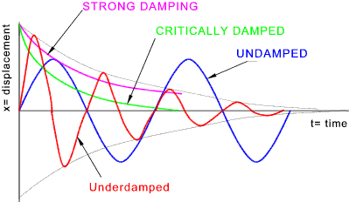
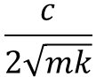
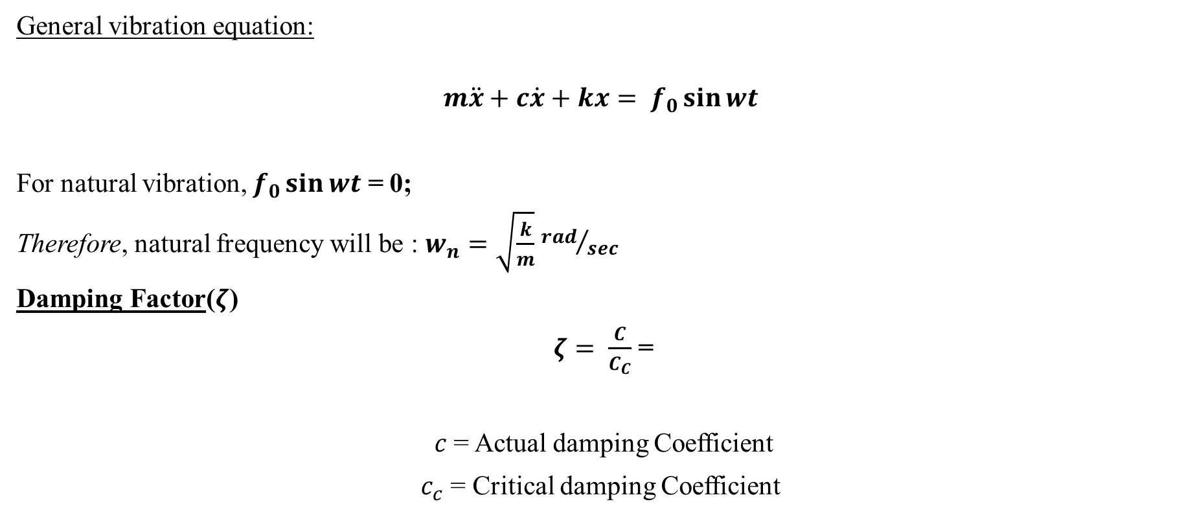
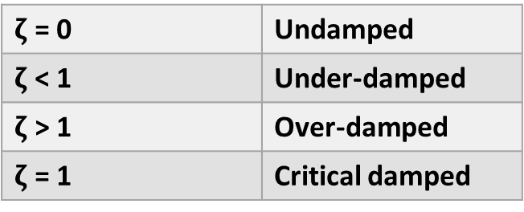
Vibration Analysis on cantilever system
General vibration equation:
$$m\ddot{x}+c\dot{x}+kx= f_{0}\sin{wt}$$
For natural vibration, $f_{0}\sin{wt}$ = 0;
Therefore, natural frequency will be : $w_{n}=\sqrt{\frac{k}{m}}$ ${rad}/{sec}$
Damping Factor($ζ$)
$ζ$ $= \frac{C}{C_{C}}$ =
$c$= Actual damping Coefficient
$c_{c}$ = Critical damping Coefficient
$ζ$ = 0 | Undamped
$ζ$ < 1 | Under-damped
$ζ$ > 1 | Over-damped
$ζ$ = 1 | Critical damped
$$\frac{c}{2\sqrt{mk}}$$

Slide 10
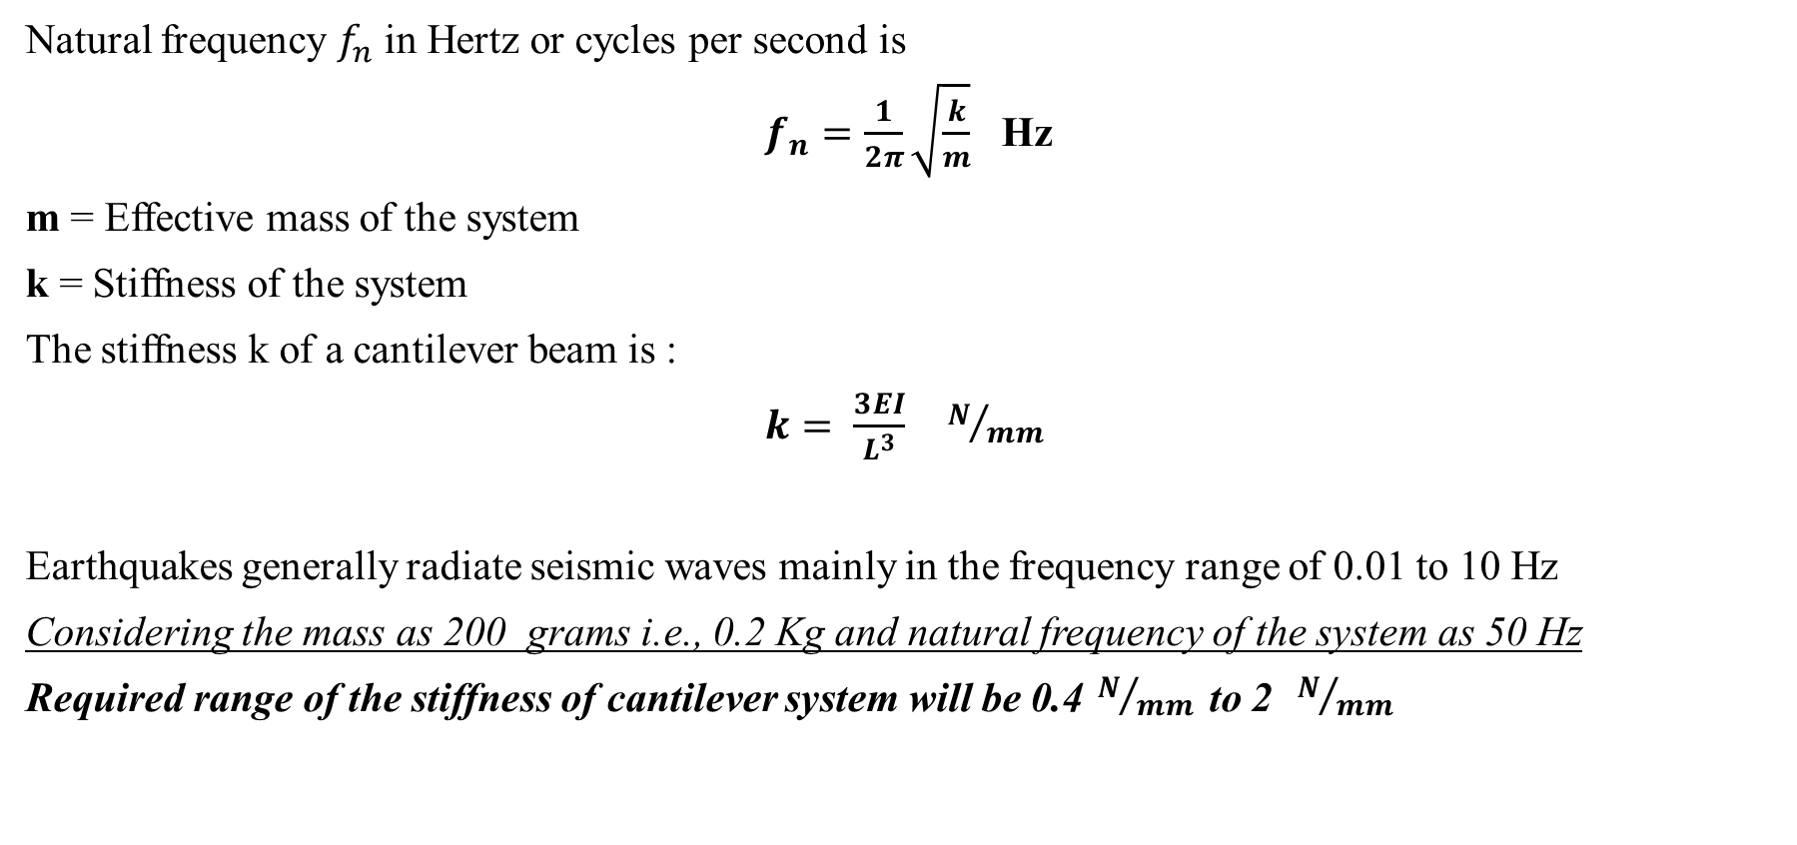
Calculation for stiffness of cantilever
Natural frequency $f_{n}$ in Hertz or cycles per second is
$f_{n}=\frac{1}{2π}\sqrt{\frac{k}{m}}$ Hz
m = Effective mass of the system
k = Stiffness of the system
The stiffness k of a cantilever beam is :
$k= \frac{3EI}{L^{3}}$ $N/{mm}$
Earthquakes generally radiate seismic waves mainly in the frequency range of 0.01 to 10 Hz
Considering the mass as 200 grams i.e., 0.2 Kg and natural frequency of the system as 50 Hz
Required range of the stiffness of cantilever system will be 0.4${ N}/{mm }$ to 2 ${ N}/{mm }$

Slide 11
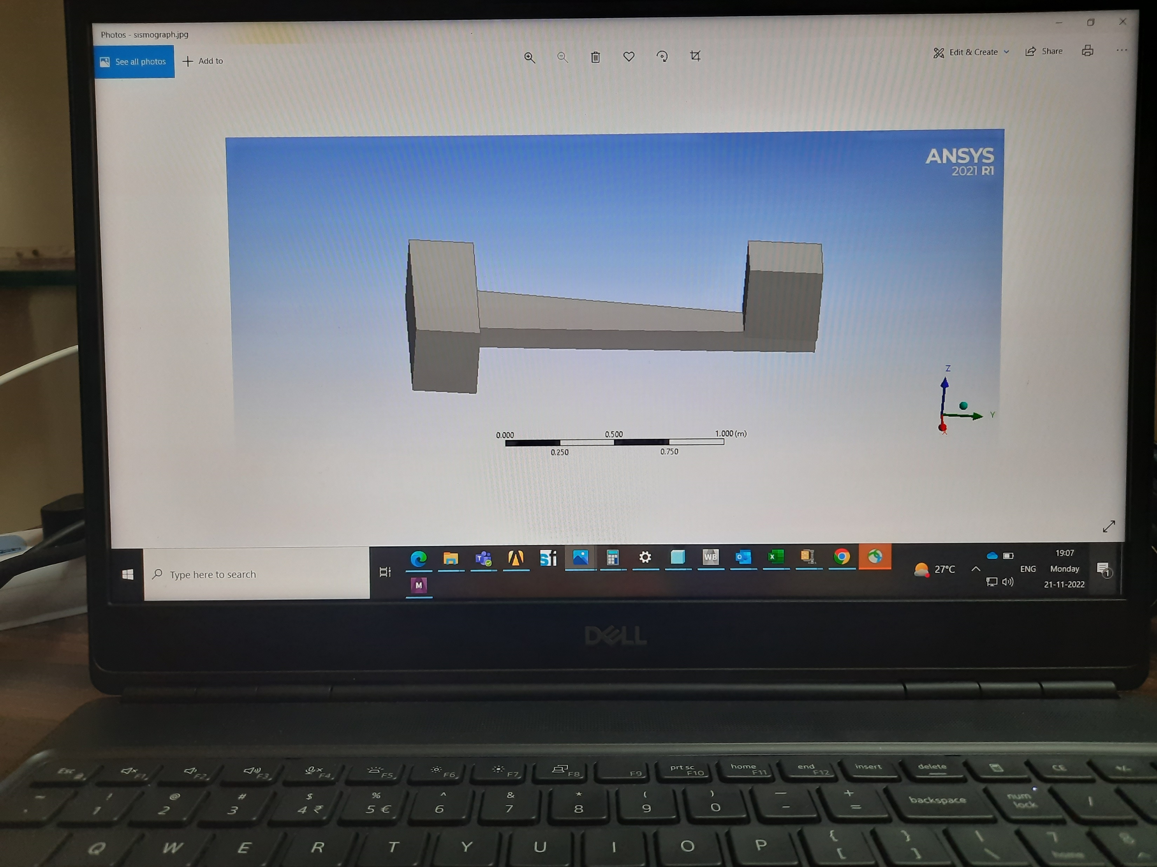
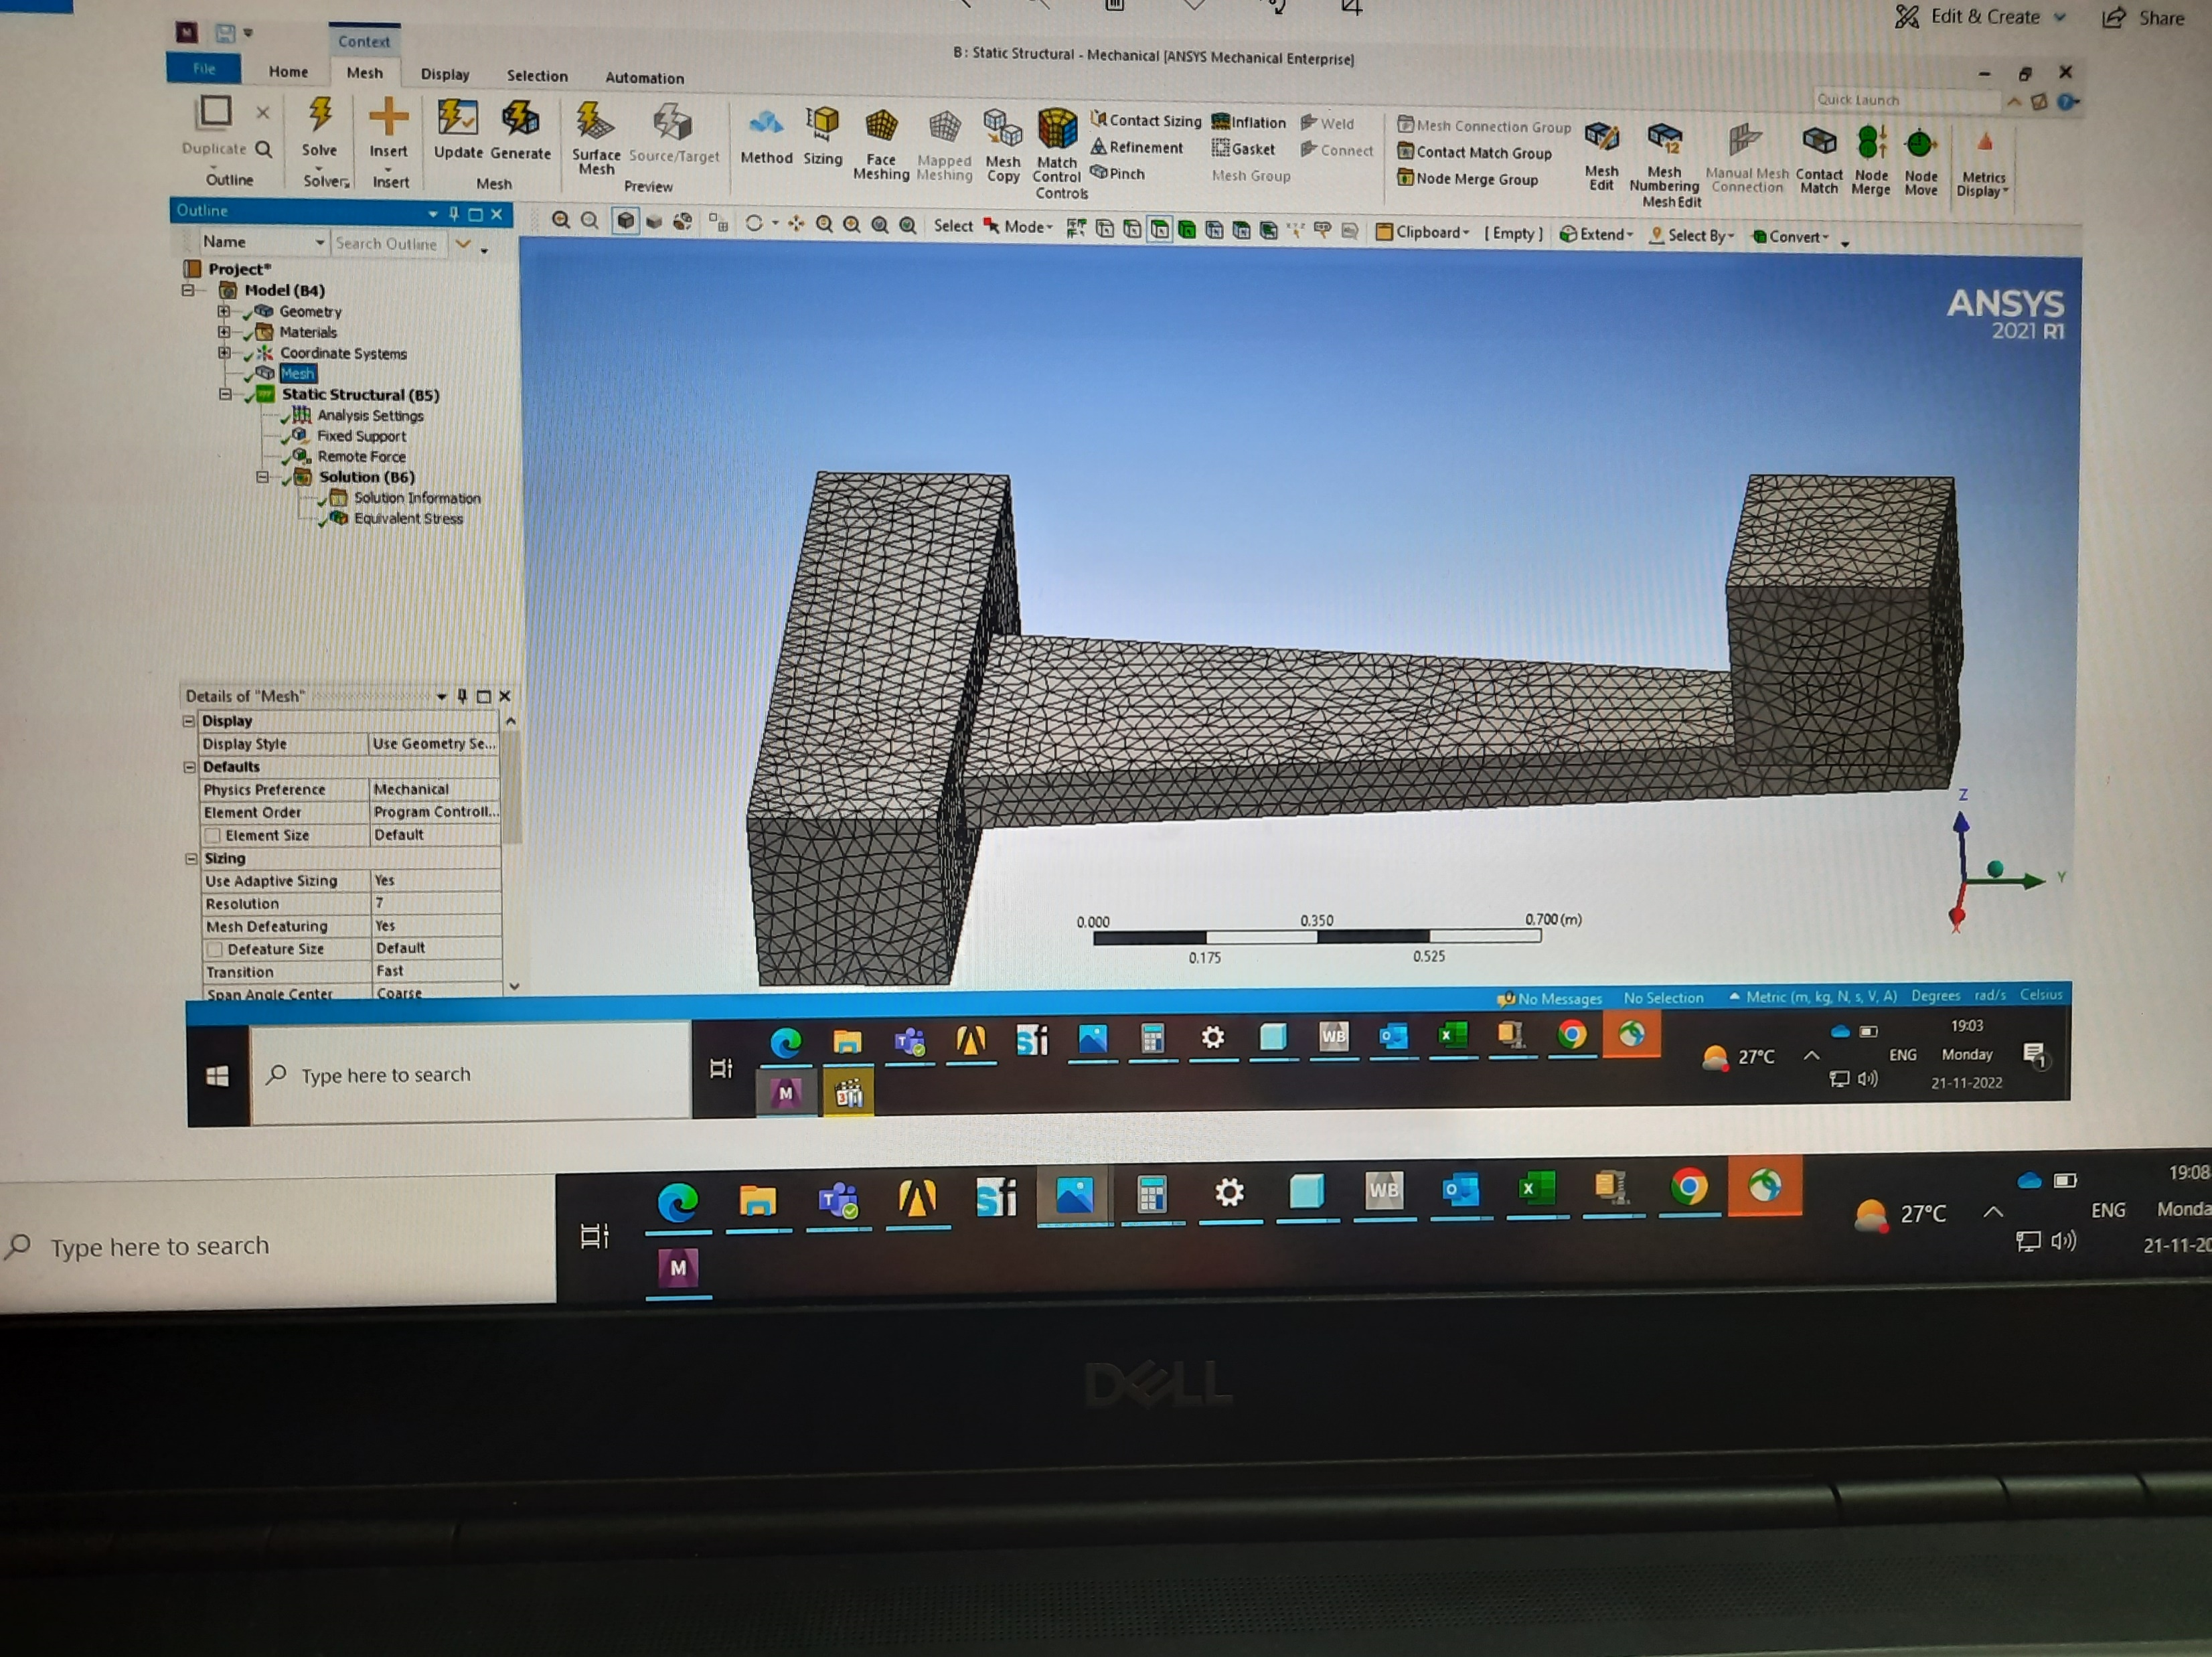
Design and Simulation of cantilever beam
Fig. 4
CAD design of the cantilever beam using stainless steel as a material
Video 1
ANSYS simulation of cantilever beam under a fixed-point seismic load
Fig. 5
Simulation of the cantilever beam using stainless steel as a material

Slide 12
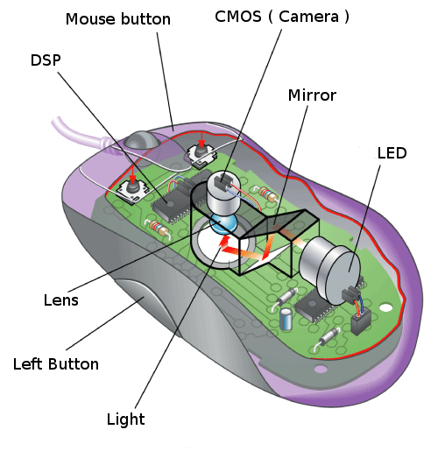
Sensor selection
Image acquisition system for our system consists of a 650 nm laser diode, diffused surface, and an optical mouse sensor.
The laser passes through the diffused surface (in plane motion) speckles are formed and when these speckles are detected by the image sensor, which is composed of sixteen hundred pixels, laid out 40 ×40.
The image sensor takes up to 17,000 pictures every single second, and thus, even if there is a slight vibration for just a tenth of a second, the image sensor would take around 1700 pictures during that quick move.
Figure 6
He, Mingxiao & Guo, Xuemei & Wang, Guoli. (2014). Enhanced Positioning Systems Using Optical Mouse Sensors

Slide 13
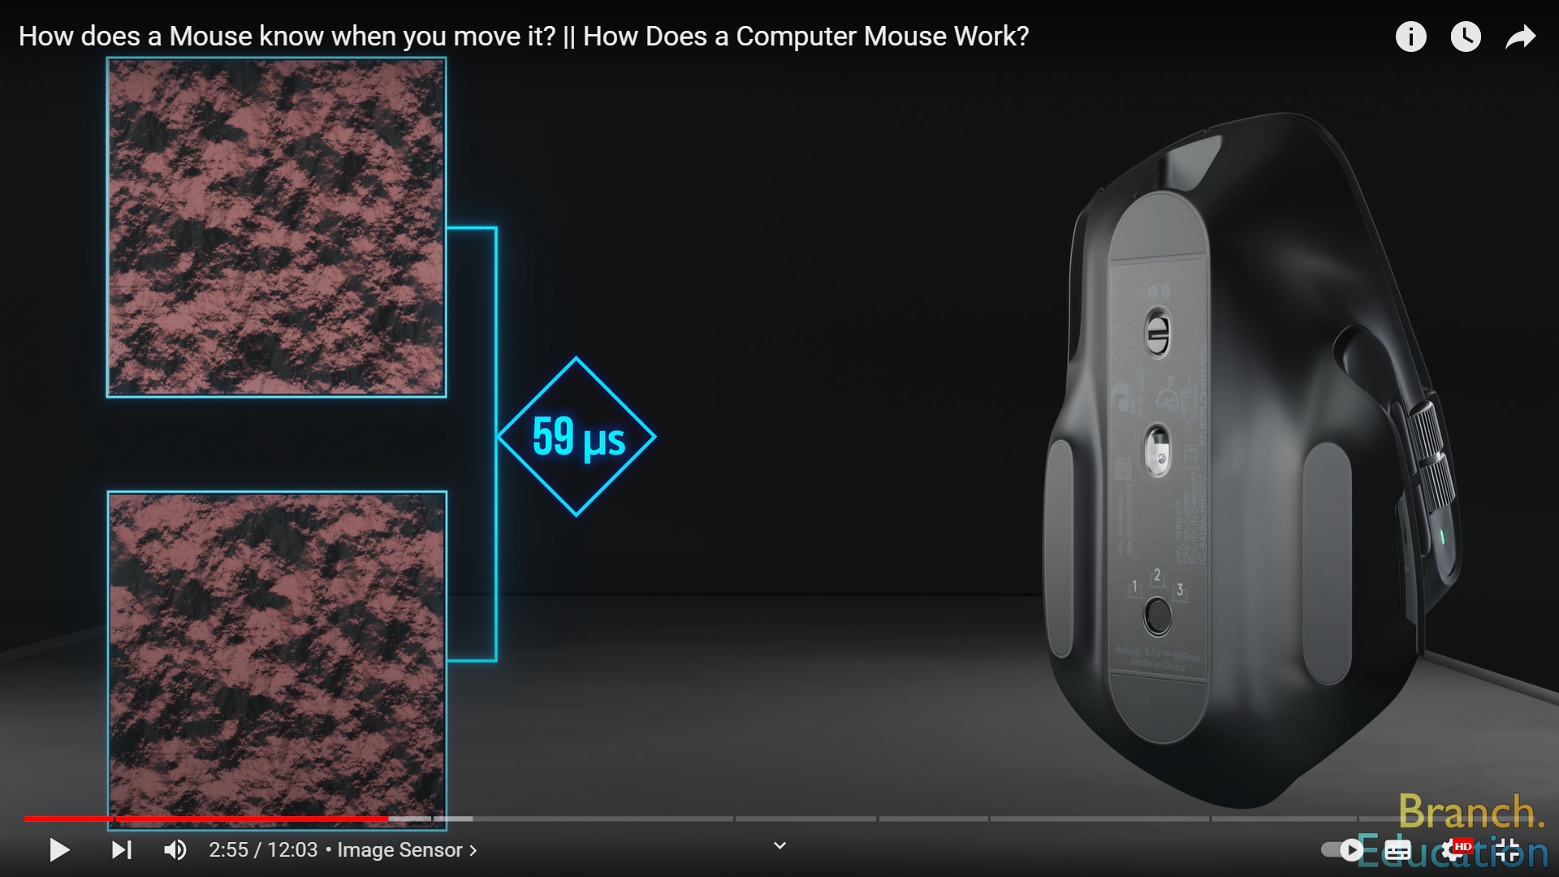
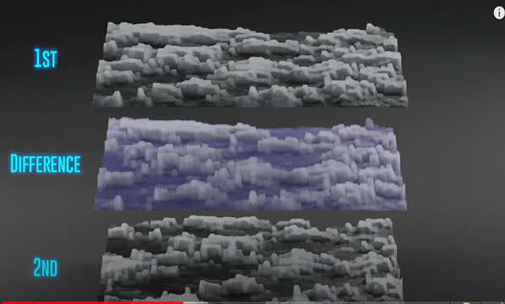
Mouse sensor doesn’t save any of these images, but rather, every time it takes a picture, it compares it to the previous one taken 59 microseconds earlier.
After these two images are compared to get the displacement of the seismic mass from the mean position.
Figure 7
He, Mingxiao & Guo, Xuemei & Wang, Guoli. (2014). Enhanced Positioning Systems Using Optical Mouse Sensors
Figure 8
He, Mingxiao & Guo, Xuemei & Wang, Guoli. (2014). Enhanced Positioning Systems Using Optical Mouse Sensors

Slide 14
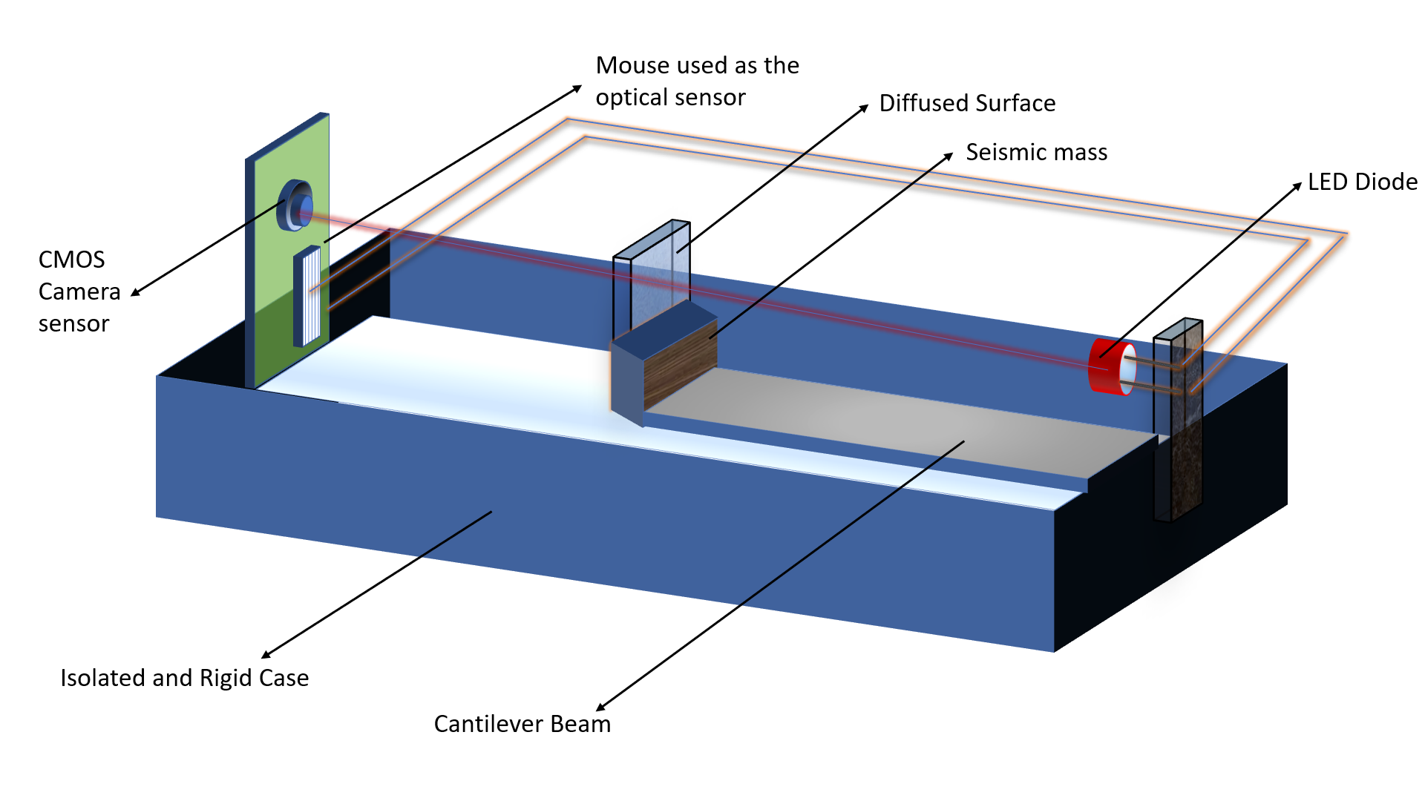
Development of a Compact System
Figure 9
Schematic diagram of compact optical seismometer

Slide 15
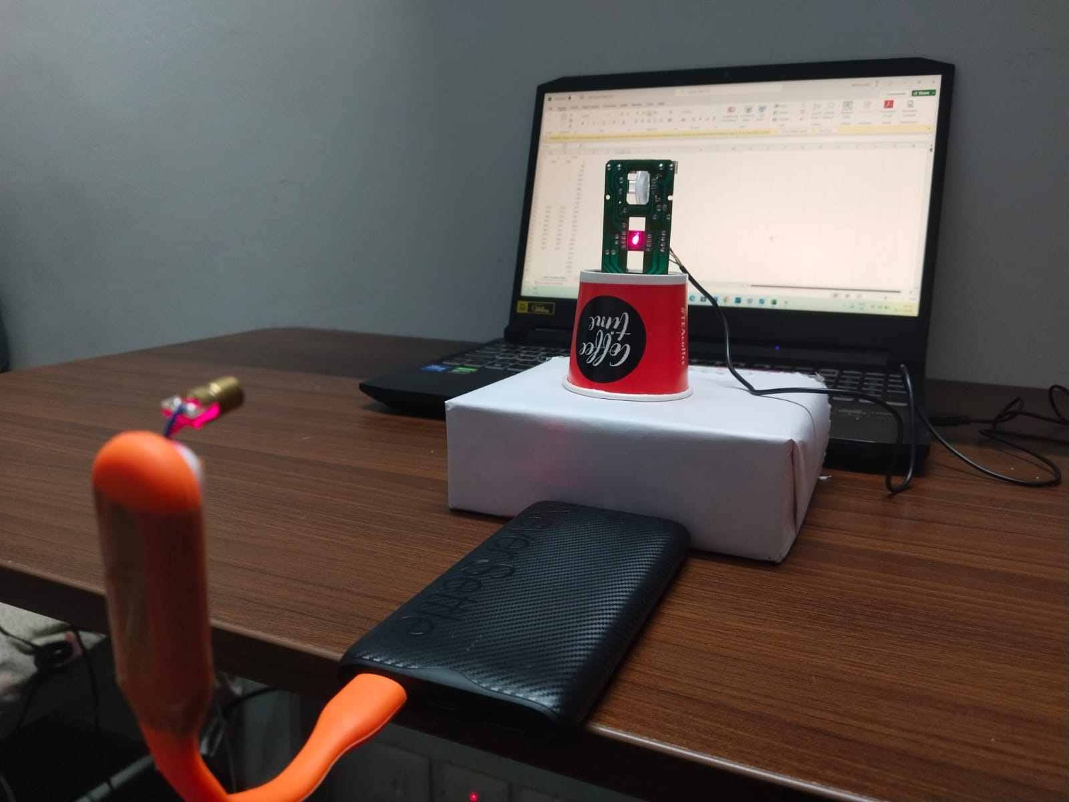
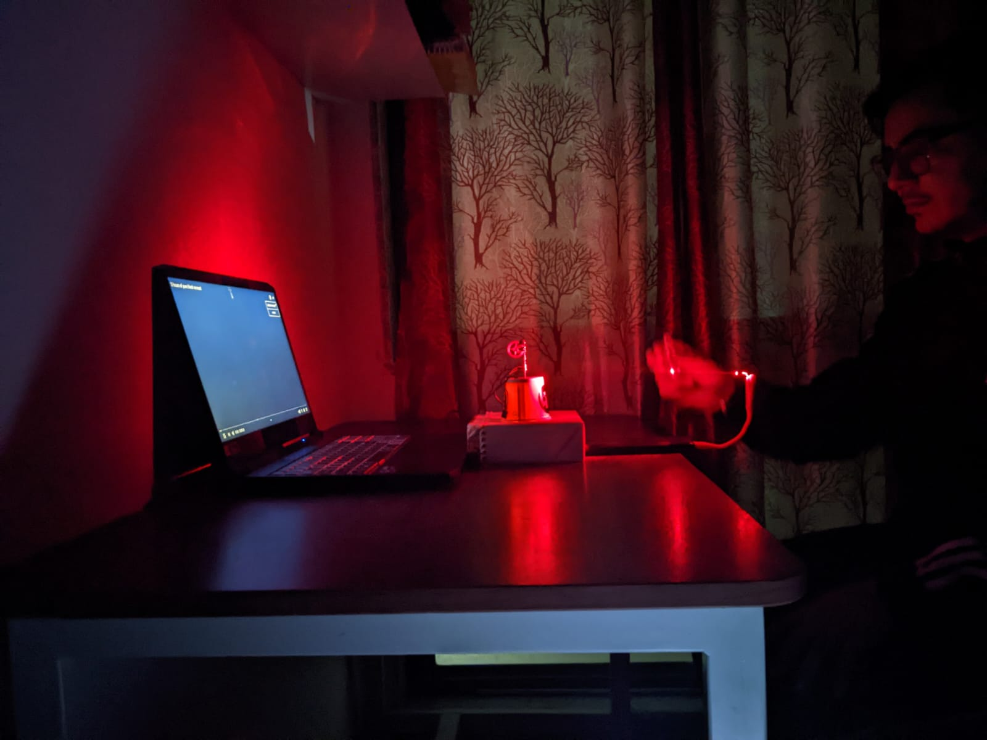
Compact Optical Seismometer Setup
Figure 10.a
Figure 10.b

Slide 16
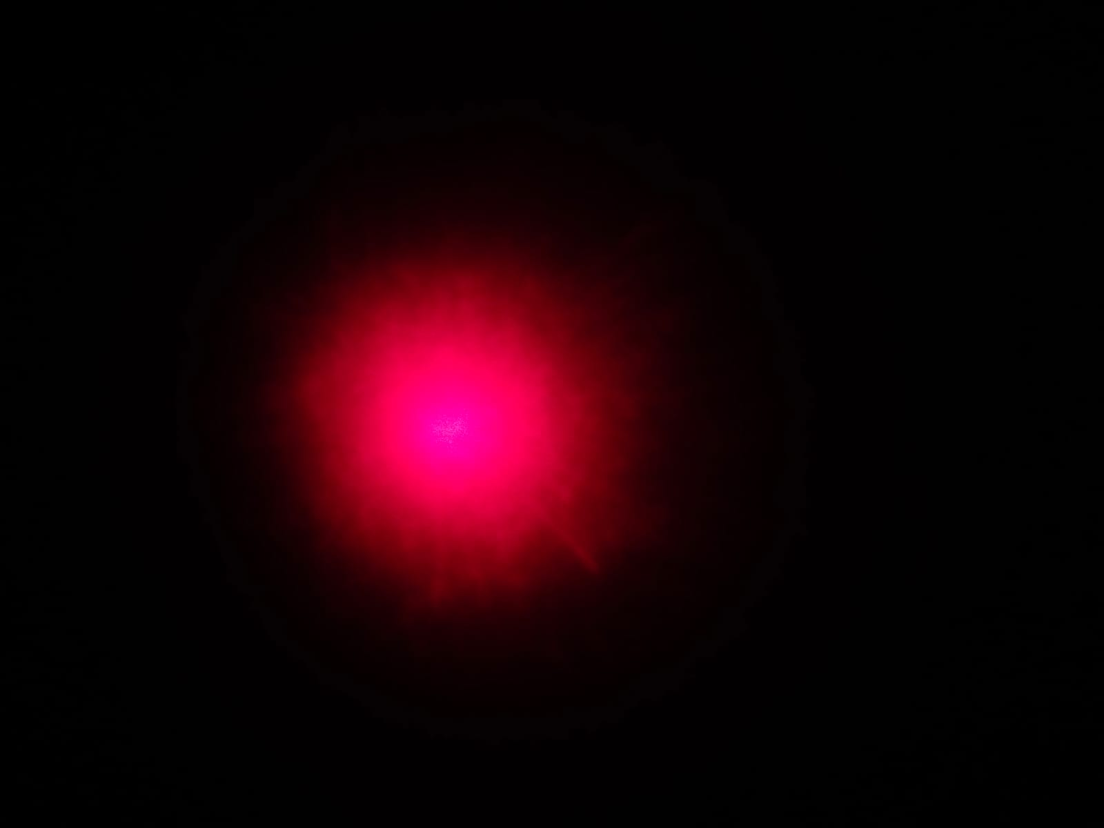
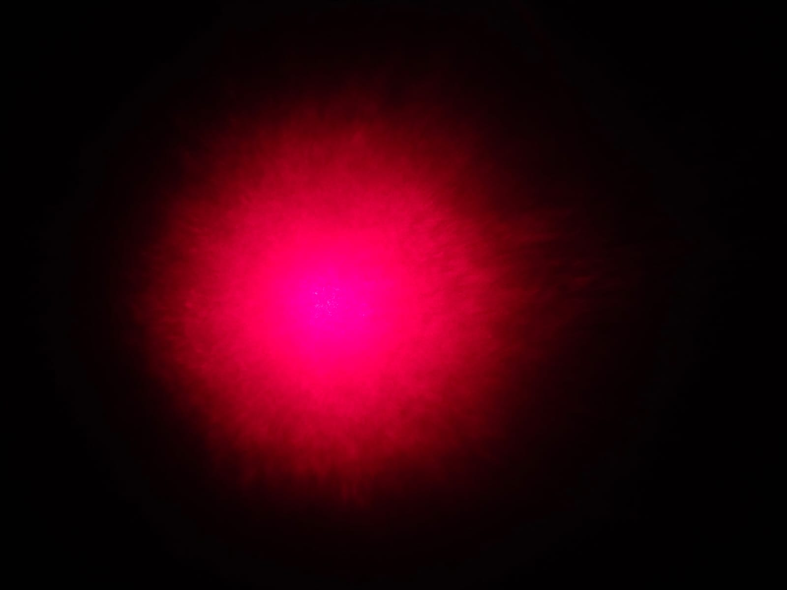
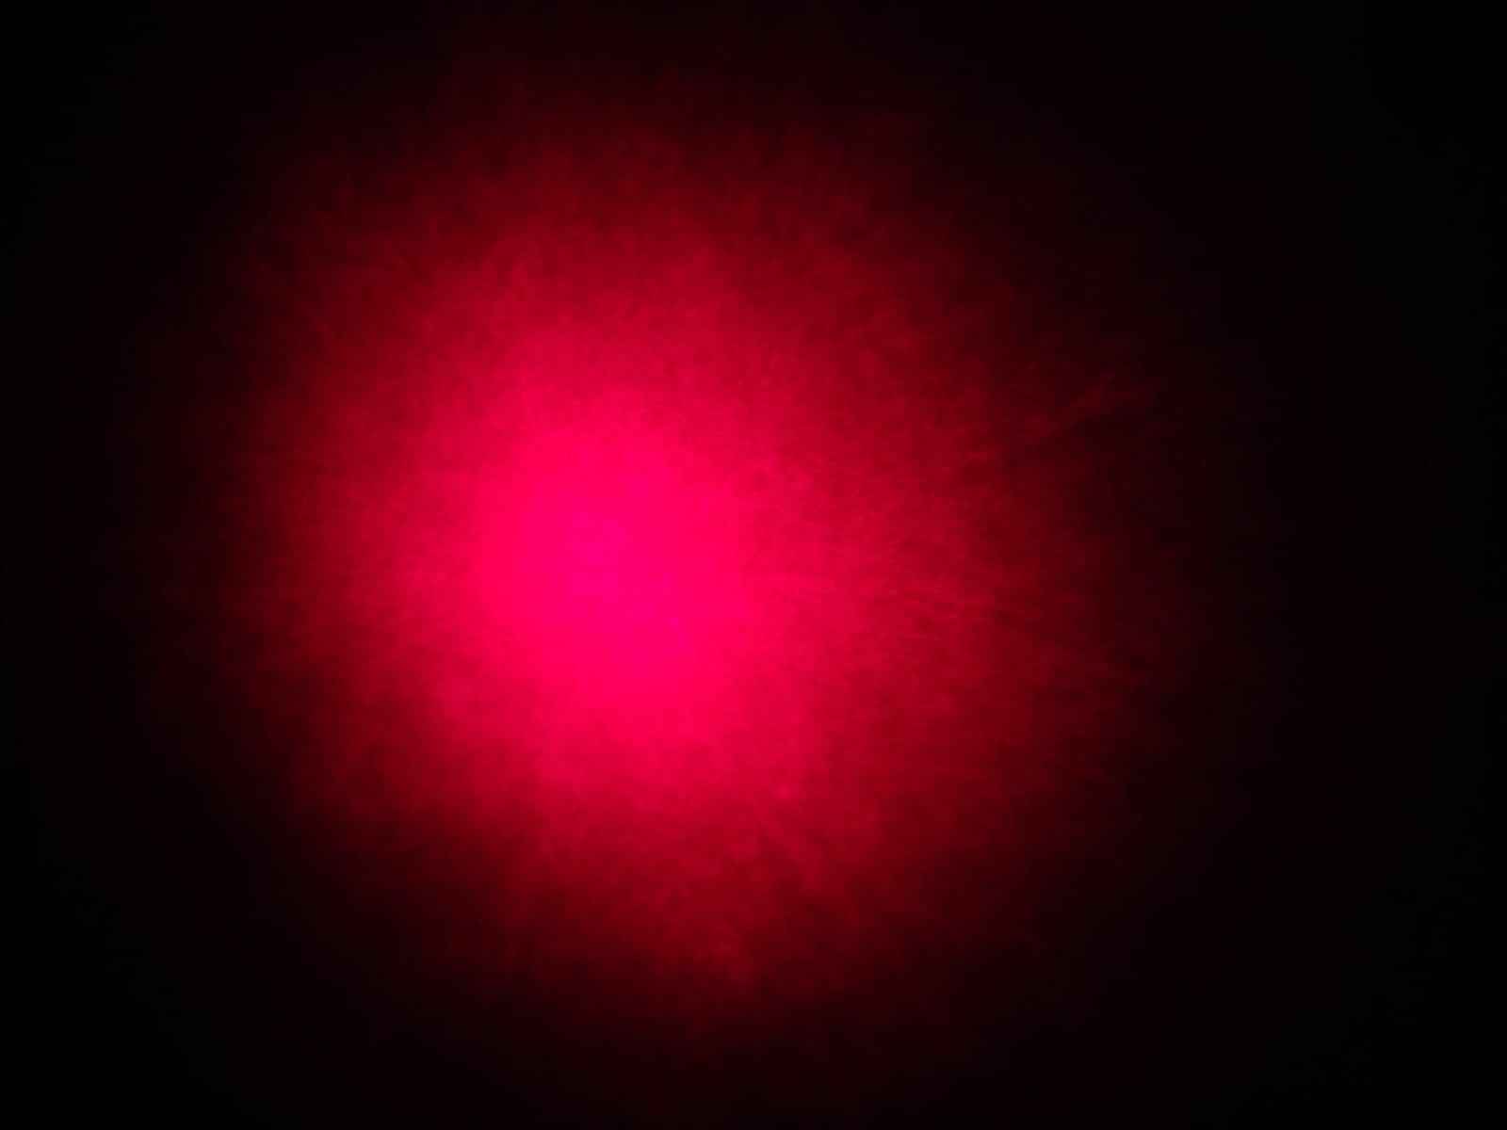
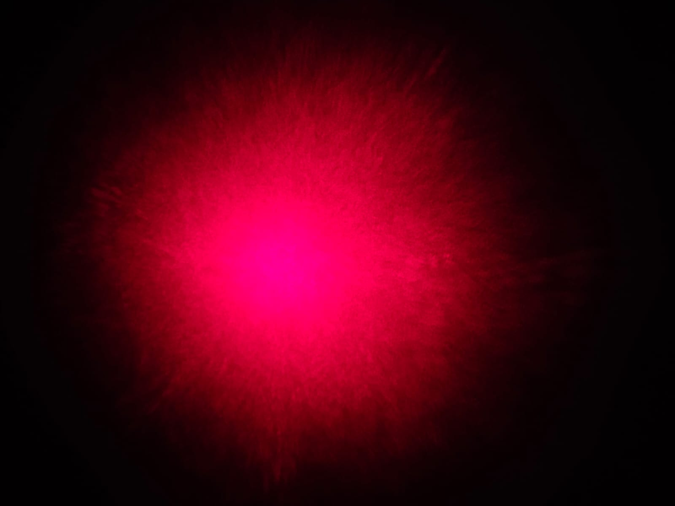
Speckle pattern under In-plane and Out-of-plane motion of diffused surface
Out-of-plane motion of diffused surface
In-plane motion of diffused surface
Image clicked when the diffused surface is kept near the wall.
Image of speckle clicked when the diffused surface is kept stationary.
Figure 11.a
Figure 12.a
Image clicked when the diffused surface is kept near the laser diode.
Image of speckles clicked when the diffused surface is provided a small in-plane motion.
Figure 11.b
Figure 12.b
* All images are captured using the smartphone

Slide 17
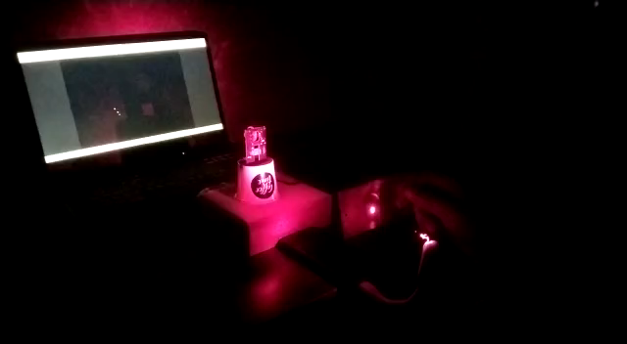
Results
Video 1
When the diffused surface is provided the in-plane motion because of the change in the speckle pattern occurs which is detected by the mouse sensor and because of which the pointer is moving .

Slide 18
Challenges faced and future work
Challenges:
Till now major challenge faced in the selection of the image acquisition system. Currently we are trying to get result with the help of mouse sensor.
After this we will be converting the cursor pointer data into the amplitude vs time graph with the help of an algorithm.
The mouse sensor has also been affected by the ambient light that has to be eliminated by the help of an isolated chamber.
Also, I faced the technical difficulties in the selection of the design of cantilever and will be trying the different-different material with geometry in various configuration.
Future Work:
Further the results obtained by this system are to be processed and various machine learning and deep learning algorithm will be implemented on the data obtained by system to predict the results.

Slide 19
References
Britannica, The Editors of Encyclopaedia. "seismograph". Encyclopedia Britannica, 29 Jan. 2020, https://www.britannica.com/science/seismograph. Accessed 28 September 2022.
Raspberry Shake upgrades to 4D in new Kickstarter https://magpi.raspberrypi.com/articles/raspberry-shake-4d
Robert E. Anthony, Adam T. Ringler, David C. Wilson, Emily Wolin; Do Low‐Cost Seismographs Perform Well Enough for Your Network? An Overview of Laboratory Tests and Field Observations of the OSOP Raspberry Shake 4D. Seismological Research Letters 2018;; 90 (1): 219–228. doi: https://doi.org/10.1785/0220180251
Moreno Oliva, Victor Ivan & Flores-Diaz, Ociel & Román-Hernández, Edwin & Campos-García, Manuel & Campos, E. & Dorrego-Portela, José & Hernández- Escobedo, Quetzalcoatl & Franco Piña, Jesus Alejandro & Perea, Alberto & Alcayde, Alfredo. (2021). Vibration Measurement Using Laser Triangulation for Applications in Wind Turbine Blades. Symmetry. 13. 1017. 10.3390/sym13061017.
F.C.L. Almeida, M.J. Brennan, F. Kroll de Lima, M.K. Iwanaga, O. Scussel, Using a geophone as an actuator to estimate the velocity of leak noise propagation in buried water pipes, Applied Acoustics, Volume 184, 2021, 108251, ISSN 0003-682X, https://doi.org/10.1016/j.apacoust.2021.108251.

Slide 20
Thank You

